Slide 1

Research Methodology & Seminar B.Tech Semester VI Institute of Technology, Nirma University
Prepared By: Sarth Narola (23BCE194) Nevil Anghan (23BCE195)
Notes:
NOTE:
To change the image on this slide, select the picture and delete it. Then click the Pictures icon in the placeholder to insert your own image.

Slide 2
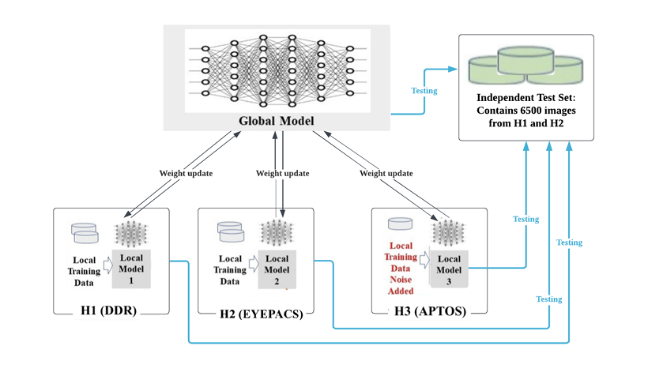
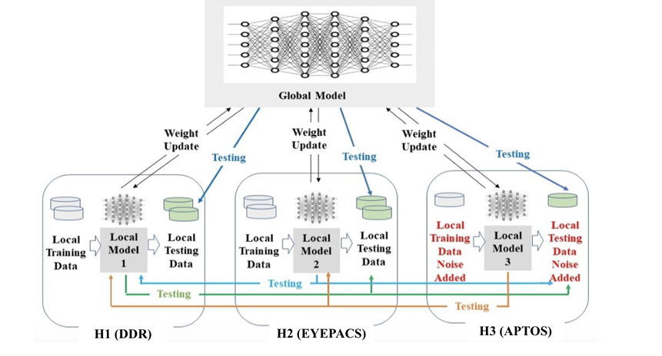
Introduction
Diabetic Retinopathy (DR) is a major cause of blindness worldwide
Medical data is privacy-sensitive and geographically distributed
Centralized training violates data privacy regulations
Federated Learning (FL) enables collaborative training without sharing raw data

Slide 3
Overview (5 Papers)
Paper | Focus Area
Paper I | FL for DR classification (FedAvg)
Paper II | Secure FL with Homomorphic Encryption
Paper III | Personalized Federated Learning
Paper IV | Vision Transformer in FL
Paper V | SCAFFOLD for client drift correction

Slide 4
Identified Research Gap
After reviewing 5 papers, we observed:
Most works use FedAvg, which suffers from client drift.
Security and personalization are rarely combined.
Cross-country domain heterogeneity is not deeply studied.
Few studies integrate:
Non-IID correction (SCAFFOLD)
Personalized FL
Secure aggregation
Limited Europe–India cross-domain experiments.

Slide 5
Final Research Gap Statement
There is no comprehensive framework that combines secure aggregation, personalized federated learning, and SCAFFOLD-based drift correction for cross-regional diabetic retinopathy classification under heterogeneous data conditions.

Slide 6
Research Objectives
Primary Objective:
To design a secure personalized federated learning framework for multi-class diabetic retinopathy classification under Non-IID cross-country datasets.
Secondary Objectives:
Compare FedAvg vs SCAFFOLD
Compare Global vs Personalized models
Analyze privacy-utility trade-off
Evaluate cross-domain generalization

Slide 7
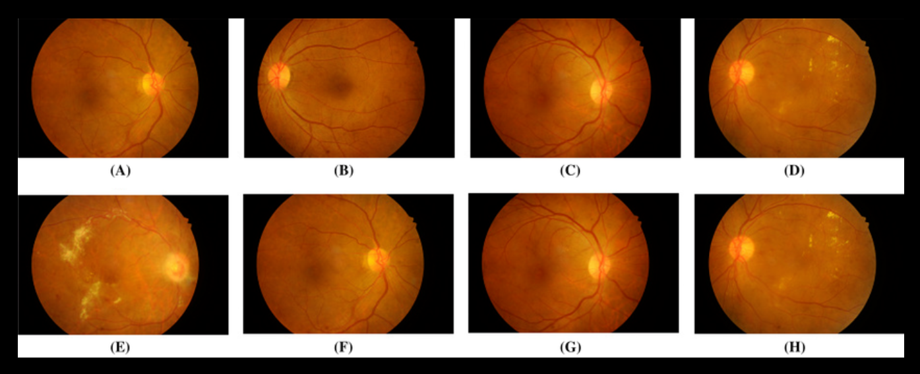
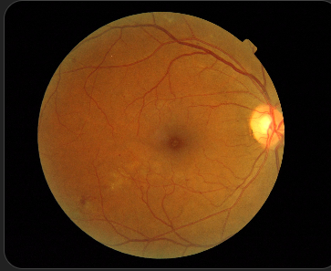
Finalized Datasets
🇮🇳 India Dataset
Indian Diabetic Retinopathy Image Dataset
Source: IEEE DataPort
Task: B. Disease Grading
516 images
Grading: 0–4
🇪🇺 Europe Dataset
BASE11 – Lariboisière Hospital (France)
100 retinal fundus images
Clinical grading: 0–3
Macular edema risk annotation
Source: ADCIS Research Portal

Slide 8
Label Harmonization Strategy
Unified 4-Class Mapping:
Unified Label | IDRiD | BASE11
0 | 0 | 0
1 | 1 | 1
2 | 2 | 2
3 | 3 + 4 | 3

Slide 9
Tools Finalized (After Review)
Component | Tool
Deep Learning | PyTorch
FL Simulation | Flower Framework
Aggregation | SCAFFOLD
Security | Differential Privacy
Visualization | Matplotlib
Evaluation | sklearn metrics

Slide 10
Finalized Methodology
Step 1 – Data Preprocessing
Resize: 224×224
Step 2 – Model
Backbone: ResNet-18 / EfficientNet
Step 3 – Federated Setup
Client 1: IDRiD (India)
Step 4 – Personalization
Fine-tune last layer locally
Add Gaussian noise to gradients (DP)
Normalize
Data augmentation
Output: 4-class softmax
Client 2: BASE11 (France)
Server: SCAFFOLD aggregation
Step 5 – Security

Slide 11
Experimental Comparisons
We will compare:
Centralized model
FedAvg (Global)
SCAFFOLD (Global)
Personalized SCAFFOLD
Secure Personalized SCAFFOLD
Metrics:
Accuracy
F1-score
AUC
Convergence rounds

Slide 12
Expected Outcomes
SCAFFOLD reduces client drift.
Personalized models outperform global models.
Secure FL slightly reduces accuracy.
Cross-country heterogeneity impacts FedAvg performance.

Slide 13
Contribution of Our Work
✔ First India–France cross-domain FL DR study
✔ Combines SCAFFOLD + Personalization + Security
✔ Addresses Non-IID explicitly
✔ Realistic hospital collaboration scenario

Slide 14
THANK YOU

